Slide 1

Quick Contact System
Darshit Patel(18012011057)

Slide 2
ABOUT PROJECT
Project Title | Quick Contact System
Internal Guide | Rachna Modi
Front-End & Back-End | Adobe Dreamweaver CS6, PHP,& My SQL.
Institute Name | U.V. PATEL COLLEGE OF ENGINEERING

Slide 3
ABSTRACT
The Project Quick Contact provides the data to both company as well as the user who require the information of different company and stores.
This Website developed with the objective of making the system reliable, easier, fast, and more informative.
By using this website the user of this site got all the information regarding the Companies or stores.
We will develop a common interface for different sections of the user and company.
We will provide all the available information of particular company when user required and also provide security to the confidential information.
Reduce the redundancy of making the entries of the activities which are done manually.
It also speed up the processing time.

Slide 4
System Configuration
Hardware & Software Configuration:
OS: Windows 10/Vista/7/8 and Linux .
CPU: Pentium III (700MHz) and above .
Memory: 128 MB and above .
Capacity: 4GB of hard drive
Coded in PHP, Adobe Dreamweaver, Notepad++ .
The software database model will support MySQL .

Slide 5
Main Purpose
A Quick Contact is a searchable online registry or index of businesses, where listings are grouped according to a category or type.
This Website collate and present the key information of the businesses listed within the directory in a readily digestible format.
The purpose of this website is to provide the user base with the information they need to become aware of, contact, locate and otherwise interact with businesses.
The information shows regarding a given business will normally include the business name, address and contact details, opening hours, photos, inbound links to the business website, and directions.

Slide 6
Modules of Quick Contact
Admin
Very Suitable for your vertical industry
Provide advance searching for directories.
Add different categories and locations.
Admin can enable or disable Directory Approval.
Admin can add, delete, changeg the status of Rreasons.
Admin can create new root categories.
User
User can create directories with multiple attributes like categories, location, website title, etc.
The User can find the directory using multiple search options like alphabetical search, advanced search, extended search, and a general search.
User can make a claim and report on the directories.
Also, the User can contact the directory owner.

Slide 7
Modules of Quick Contact
Payment Module
This module is for Payment , User can pay through online portal such as Paytm, UPI as well as can deposit cheque to bussiness owner.
In addition, they can view their amount due to pay to dealer as well as months remaining to be completed before their EMI ends.
Setting Module
In this module admin can edit profile information such as logo, business name, business address, contact, and payment gateway details.
In addition, admin can change password of the admin section by providing old password.
Category Module
Show different categories to the customer.
News and Event Module
Show different news and event to the customer.

Slide 8
Software
1. PHP:
PHP is a server-side scripting language. that is used to develop Static websites or Dynamic websites or Web applications. PHP stands for Hypertext Pre-processor, which earlier stood for Personal Home Pages. PHP scripts can only be interpreted on a server that has PHP installed. As mentioned above HTML CSS and PHP are the languages used in this project. As php is server-side language it requires a server to be interpreted. Therefore, we have used WAMP server.
2. MySQL Database:
MySQL is an OpenSource relational database Management System. MySQL operates on almost every platform UNIX, Linux, and Windows. Although MySQL is used for a large number of applications, it is most frequently associated with web applications and online publication.
Installation: Downloading MySQL
3. XAMPP:
XAMPP is a free and open-source cross-platform web server solution stack package developed by Apache Friends, consisting mainly of the Apache HTTP Server, Maria DB database, and interpreters for scripts written in the PHP and Perl programming languages

Slide 9
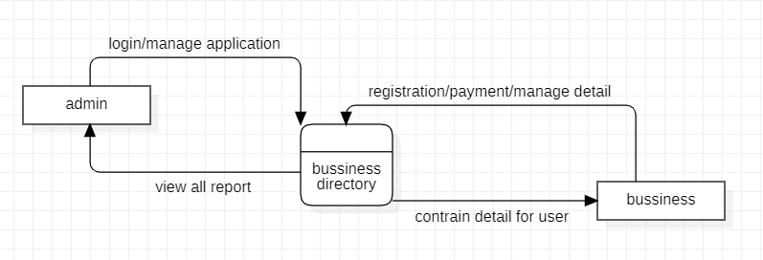
DFD ZERO LEVEL

Slide 10
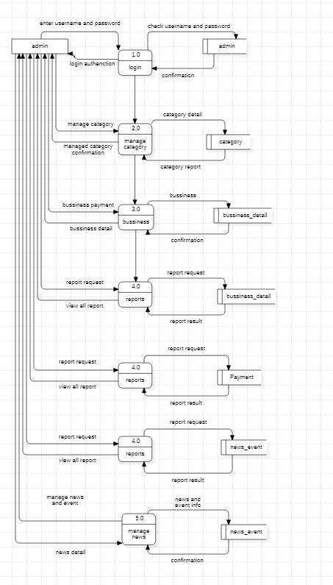
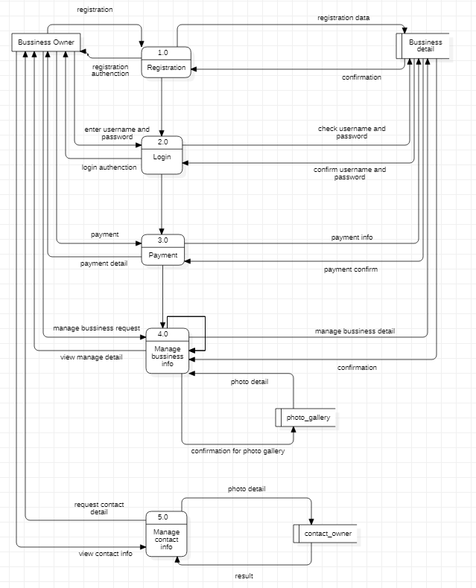
DFD Diagram

Slide 11
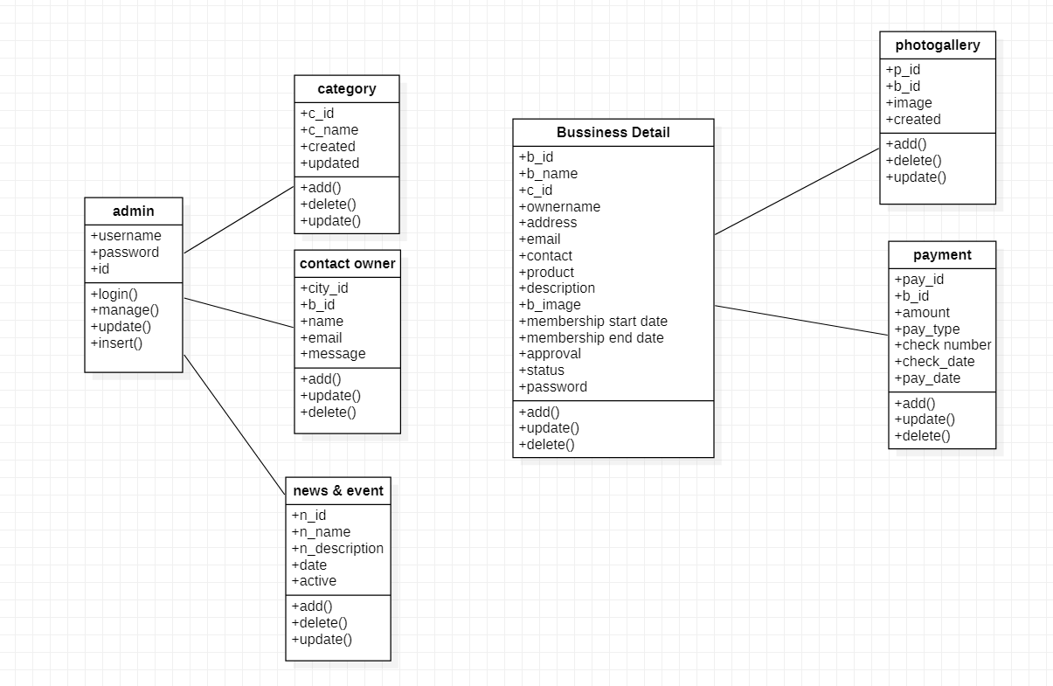
Class Diagram

Slide 12
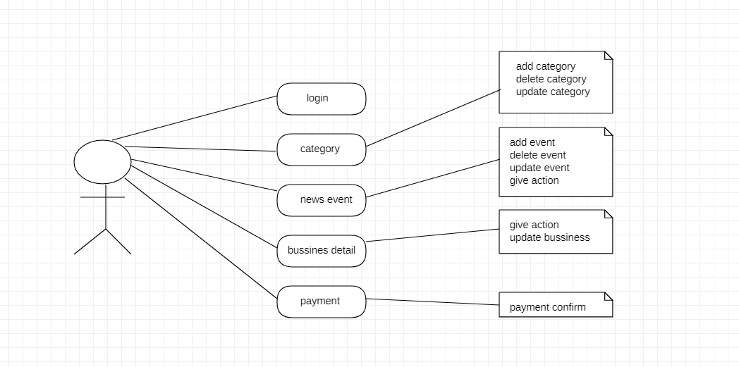
Use Case Diagram

Slide 13
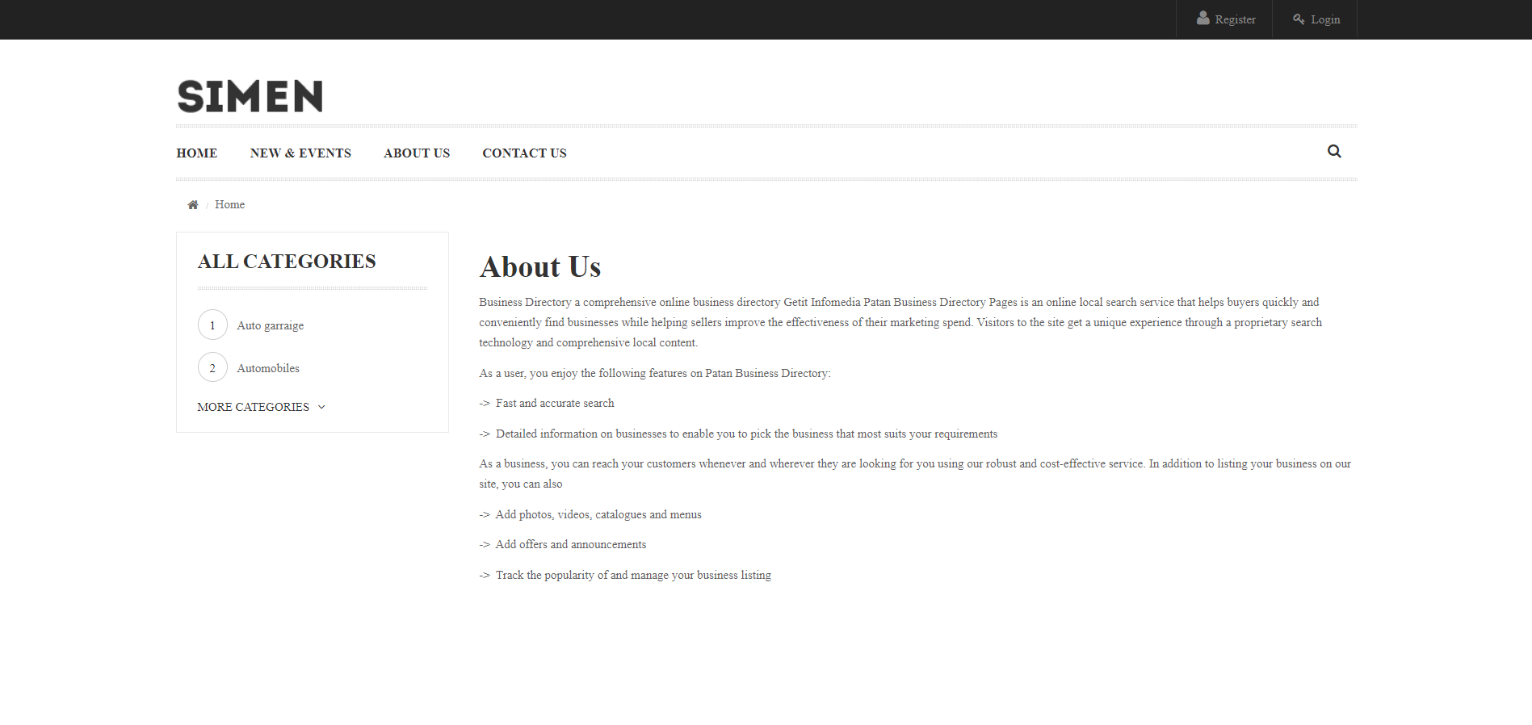
1

Slide 14
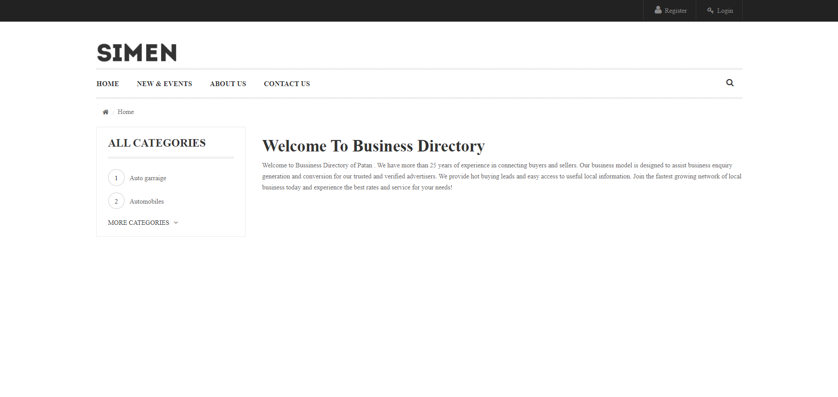

Slide 15
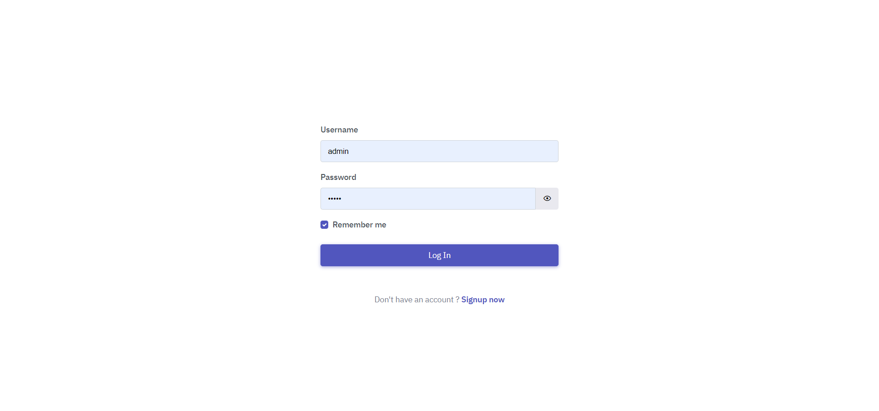

Slide 16
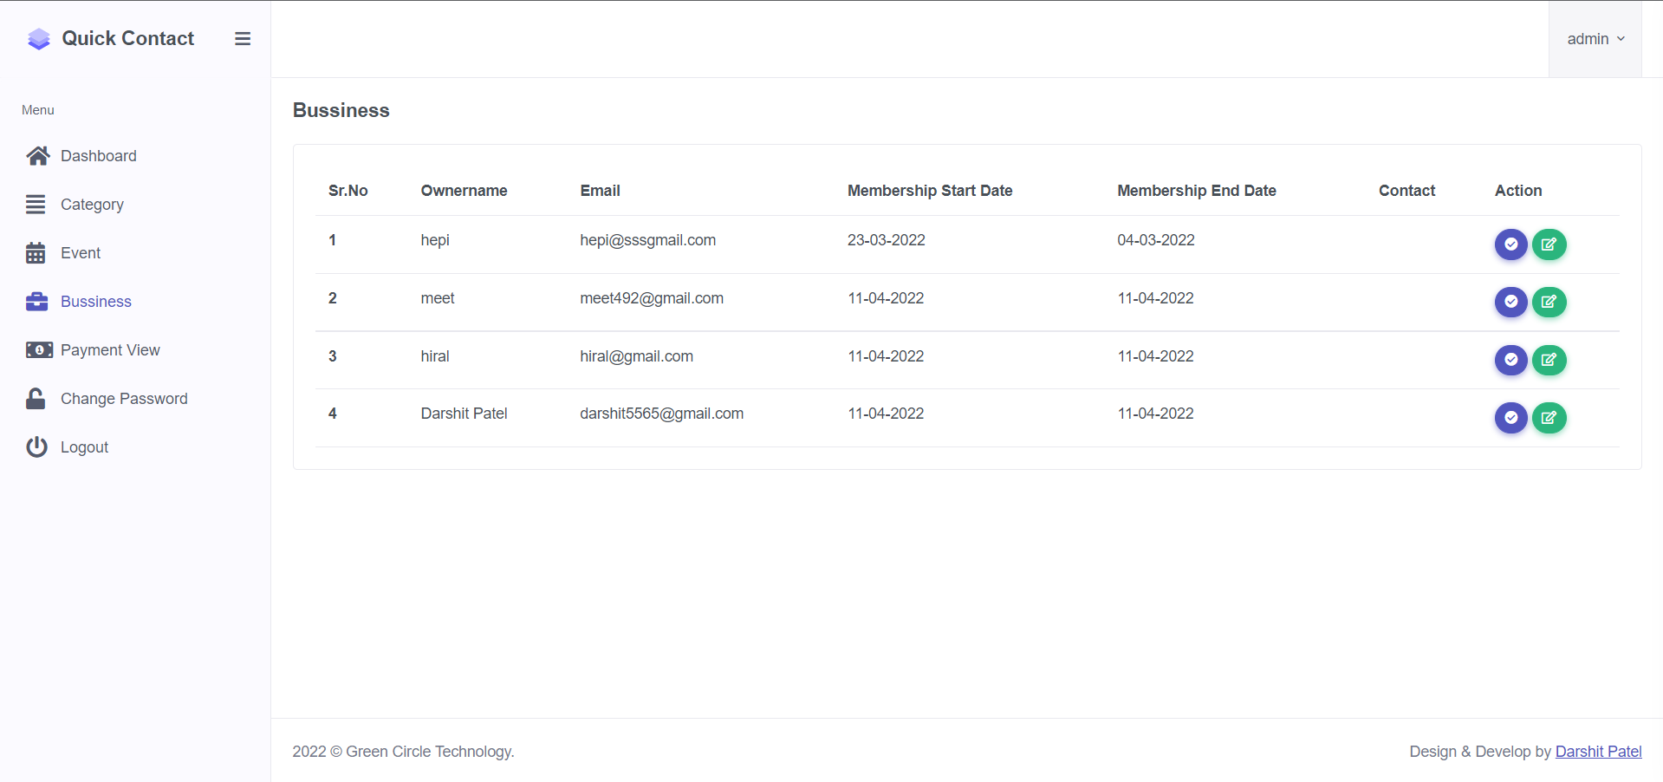

Slide 17
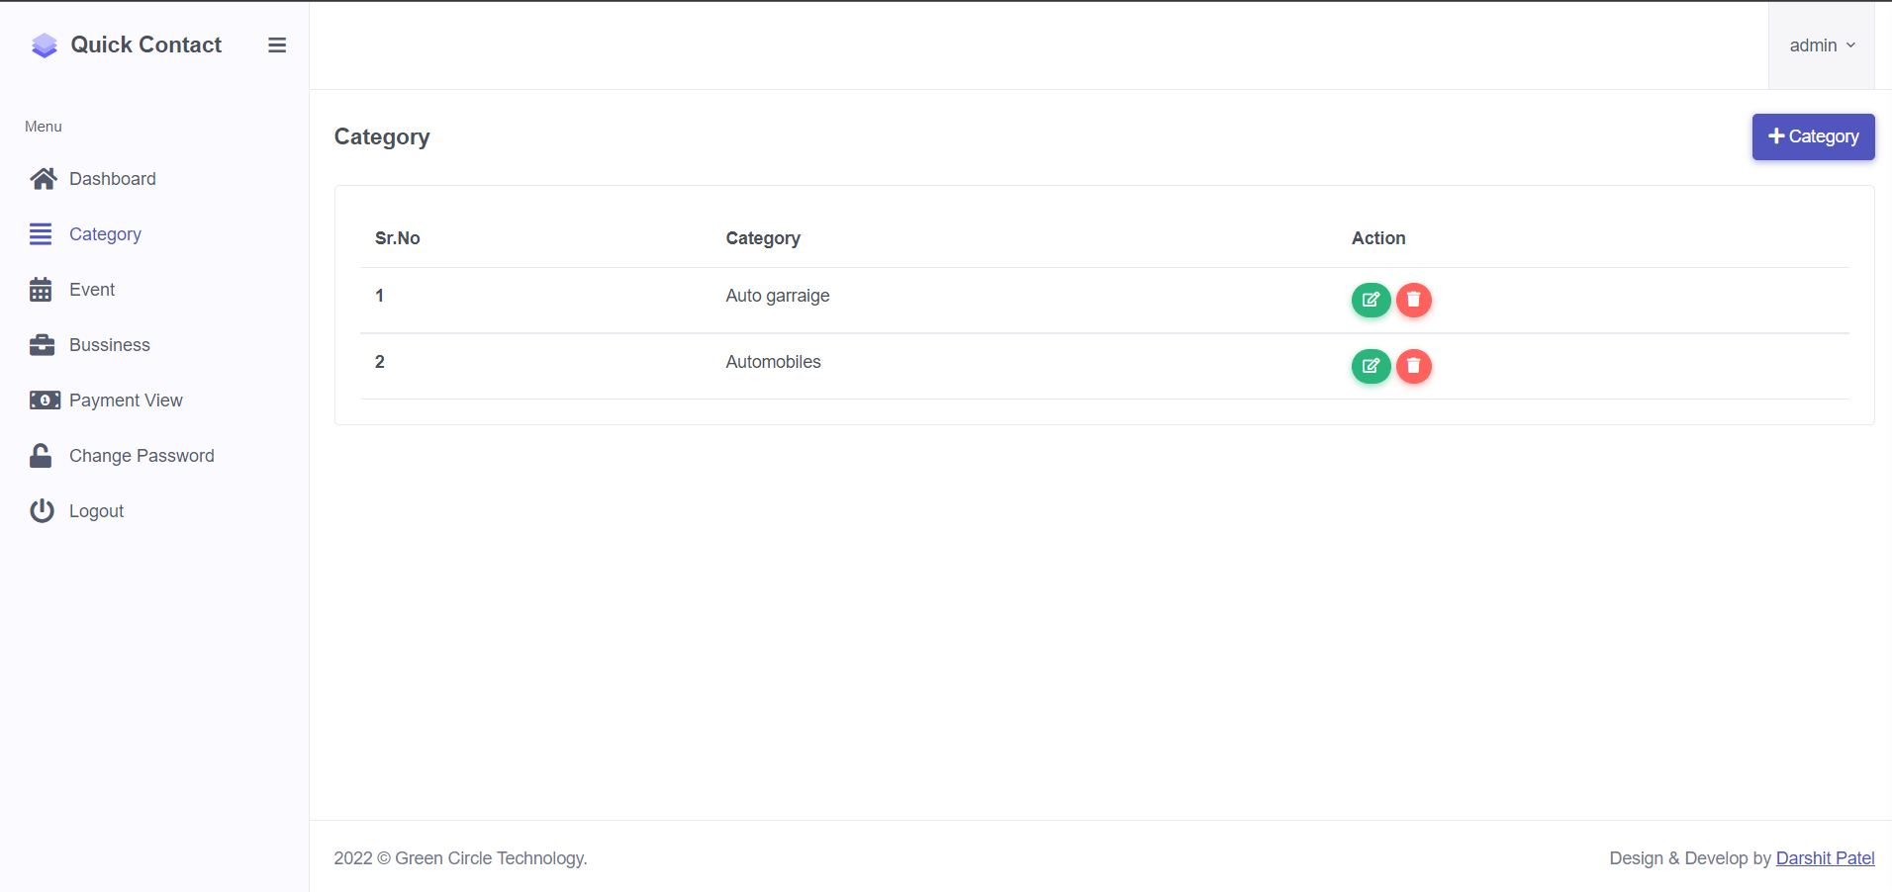

Slide 18
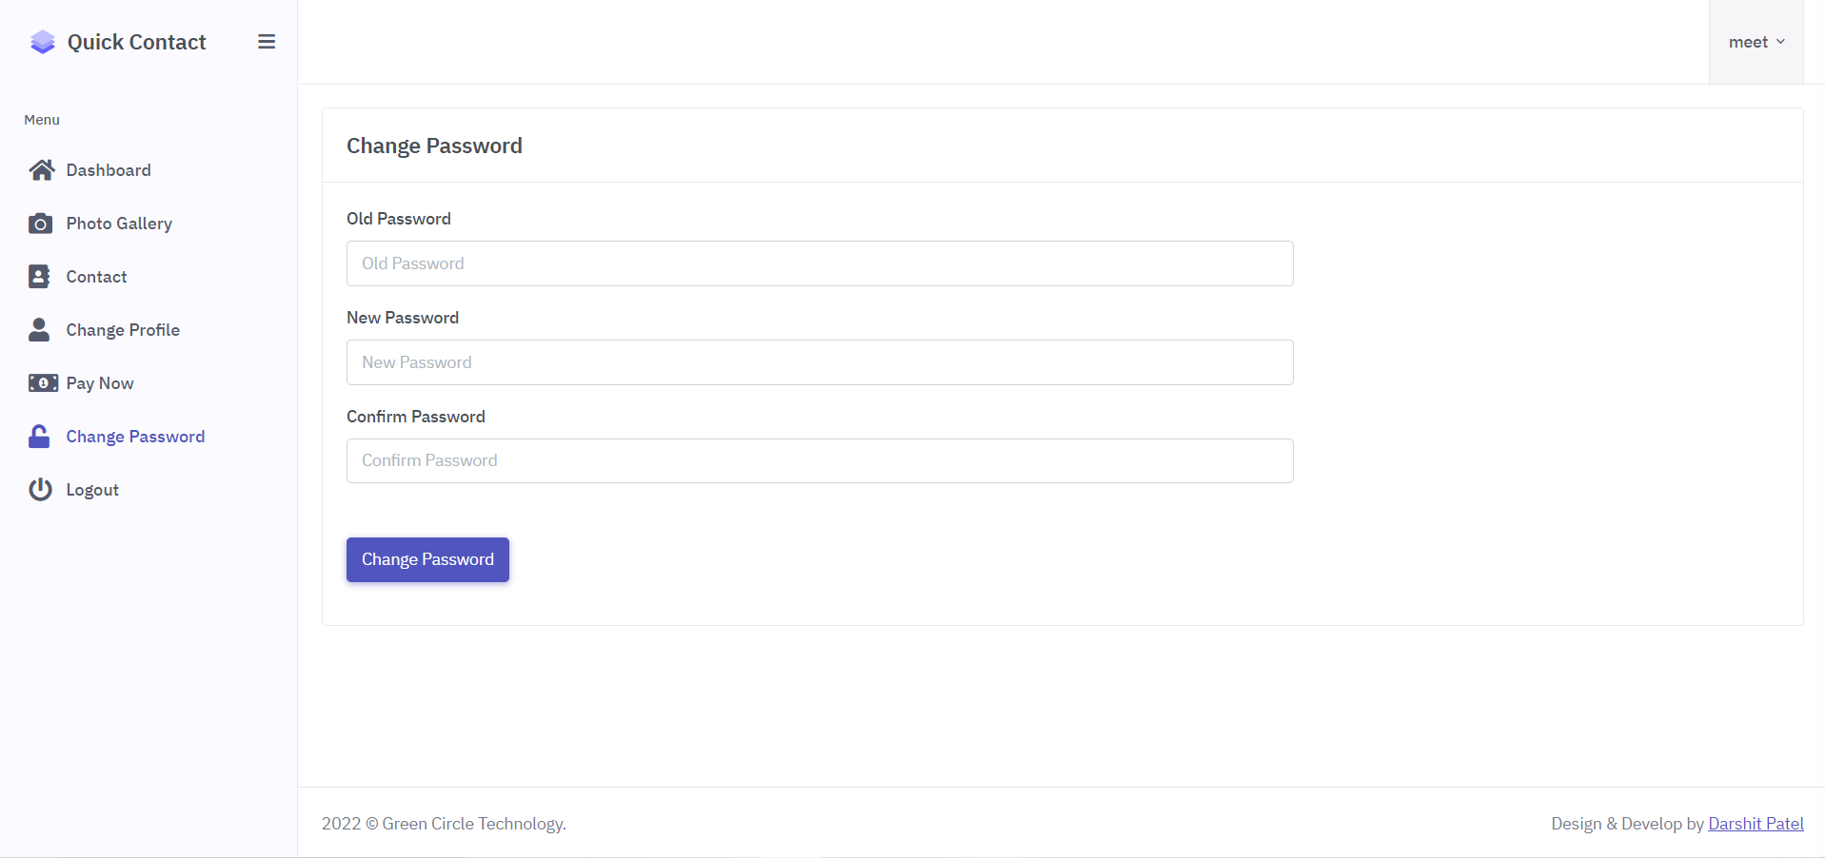

Slide 19
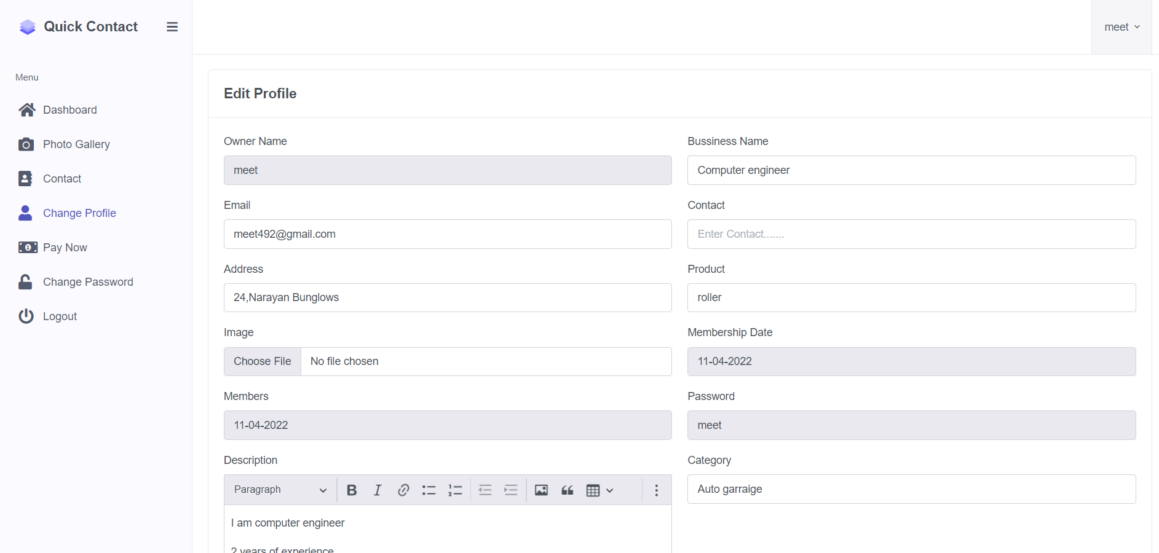

Slide 20
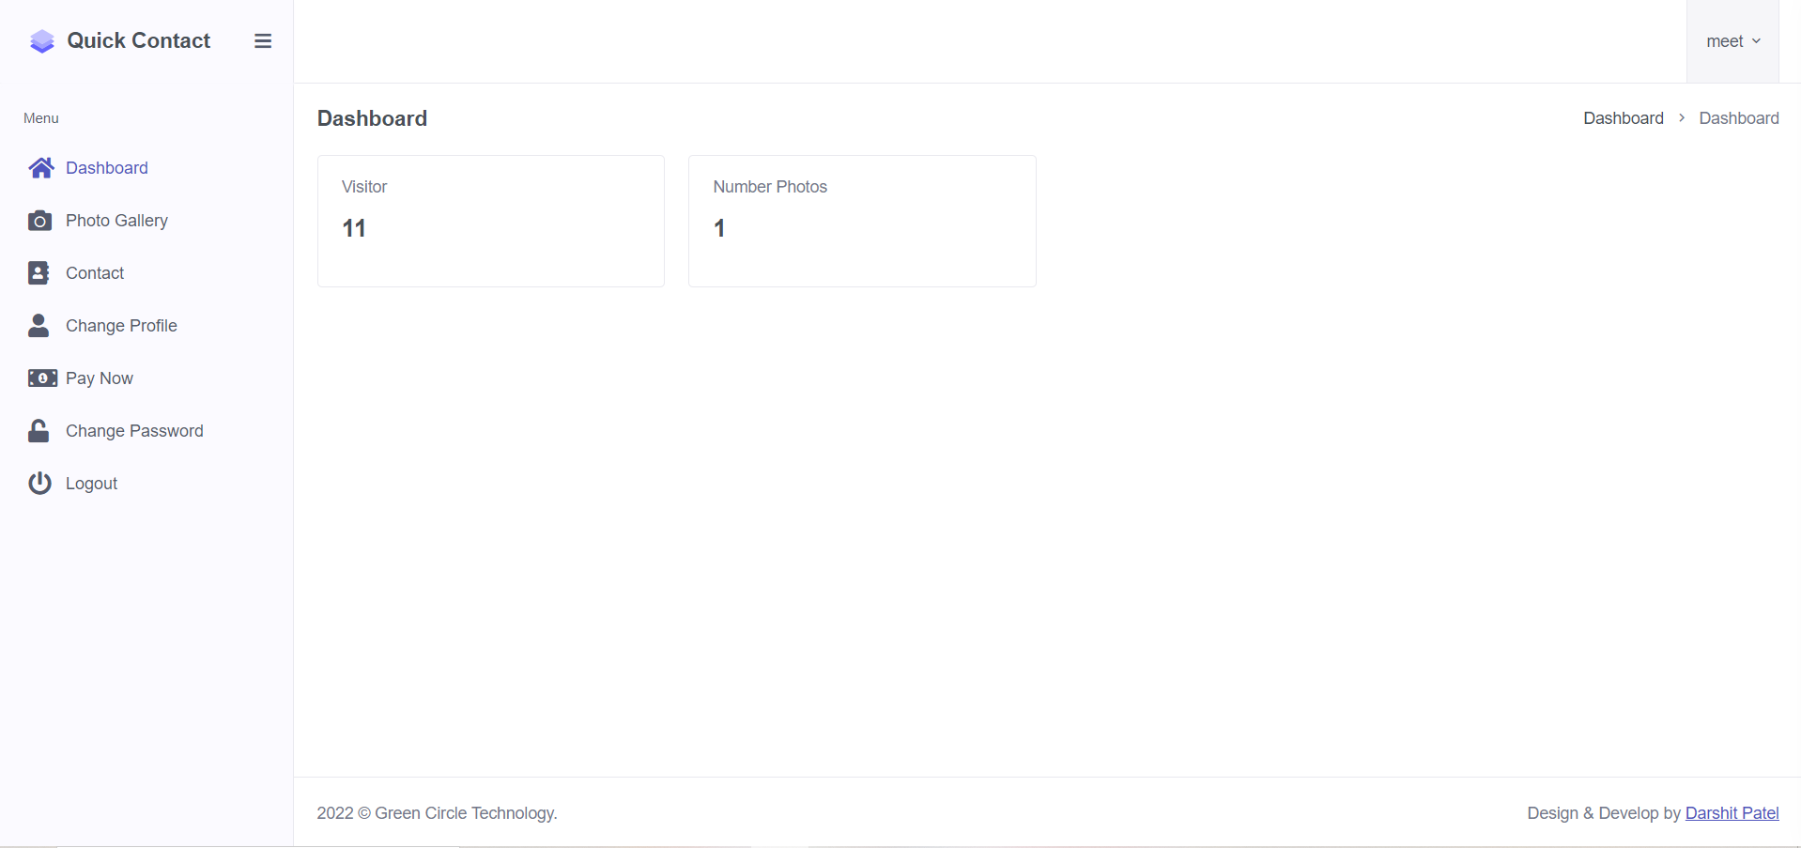

Slide 21
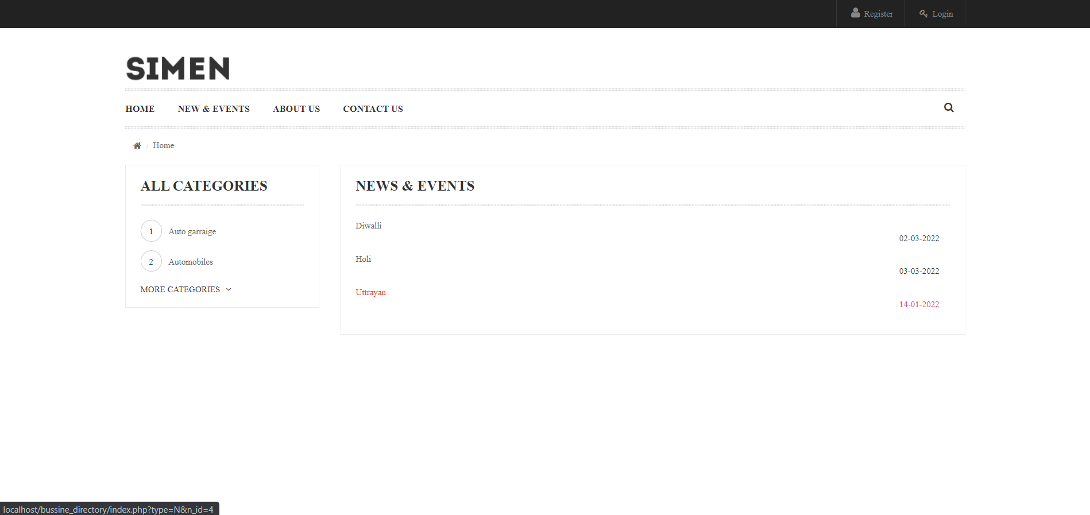

Slide 22
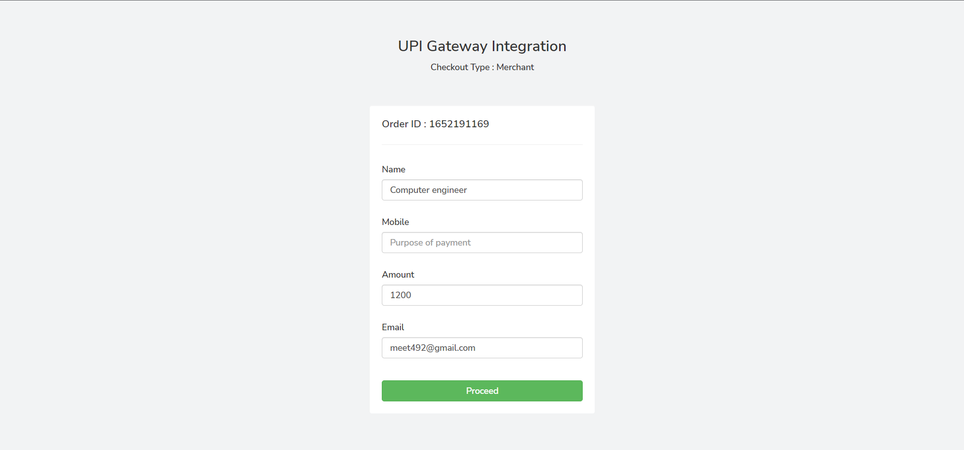

Slide 23
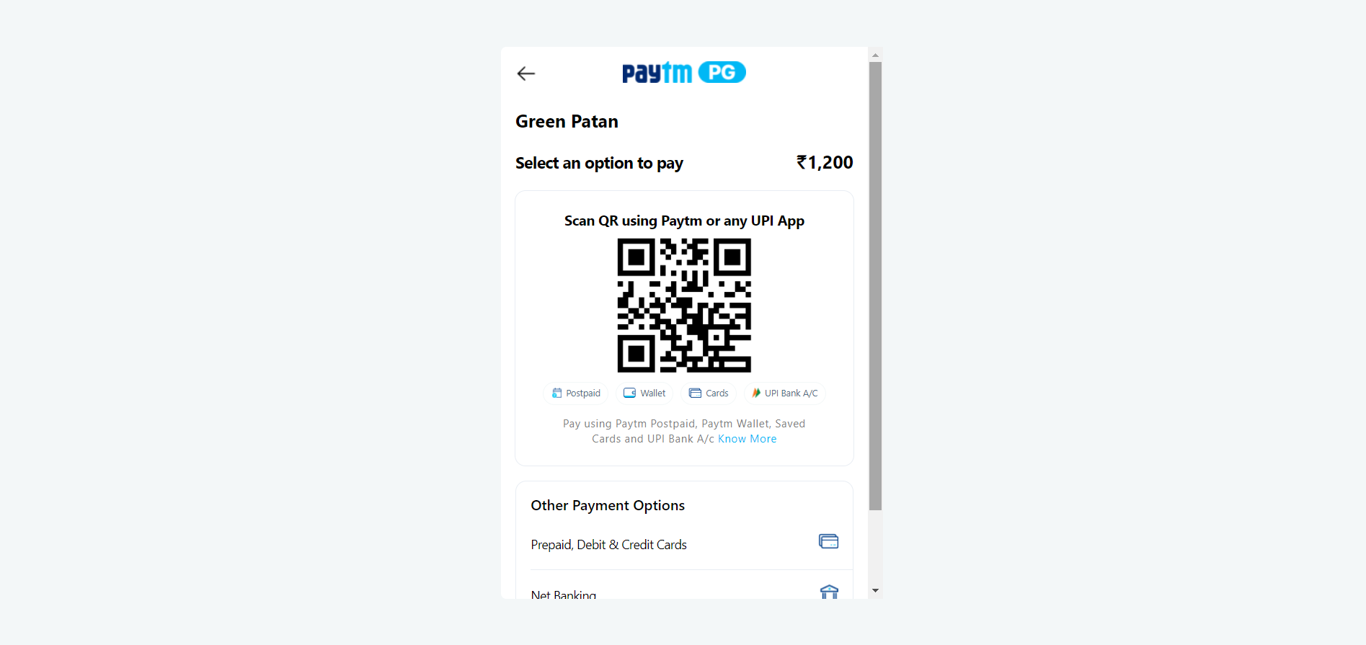

Slide 24

l
PRESENTED By: Darshit Patel(18012011057)

